Slide 1
Insights of Movie Metrics
Noah Dolan
Binod Gaihre
Jayla Gary
Deysi Paniagua

Slide 2
Introduction
This project analyzes data from TMDB (The Movie Database) and contains data released from 1916-2017.
Columns featured in this project include budget, genres, original language, popularity, released date, revenue, title, vote average and count, and director.
The data set was aggregated accordingly to allow for analysis of each question.

Slide 3
Top Five Genres
History
War
Drama
Comedy
Thriller
Action
Romance
History
War
Drama
Animation
Foreign
With respect to Number of movies
With respect to Ratings

Slide 4
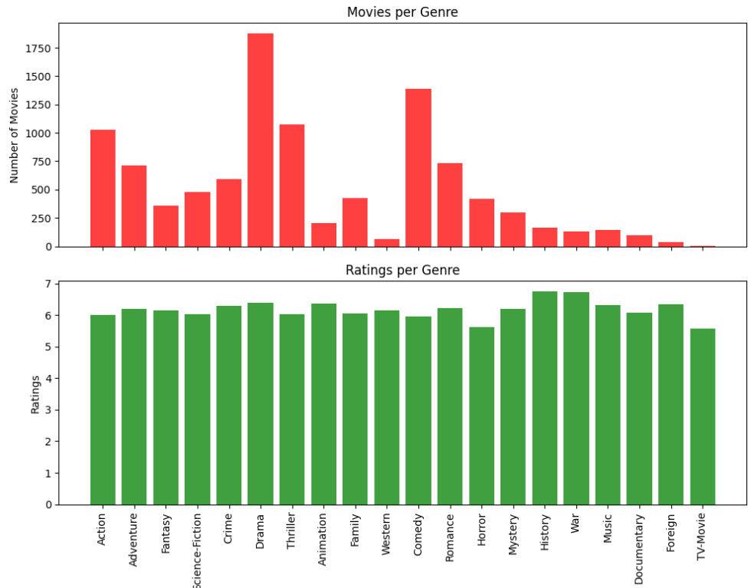

Slide 5
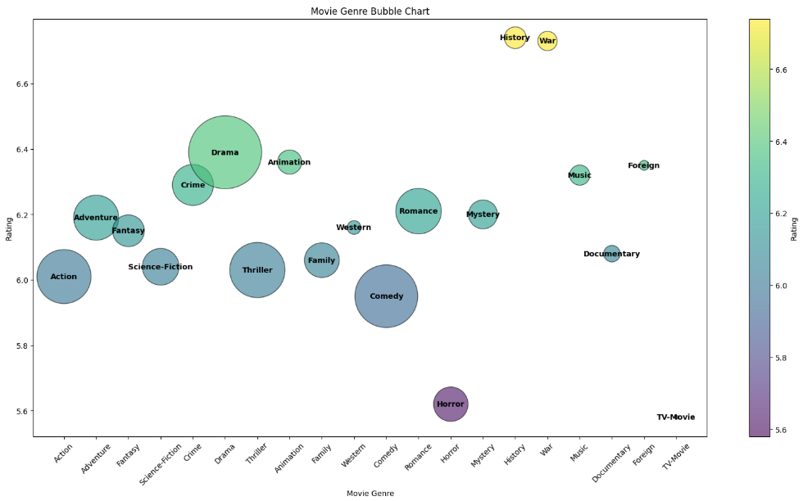

Slide 6
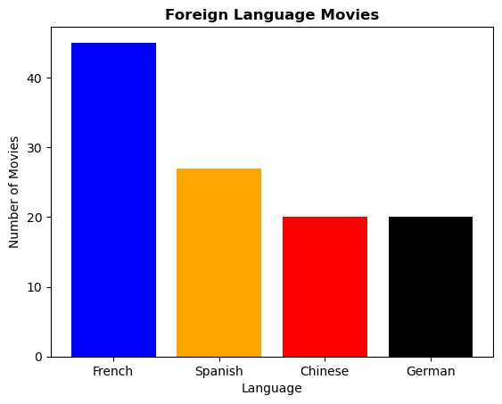
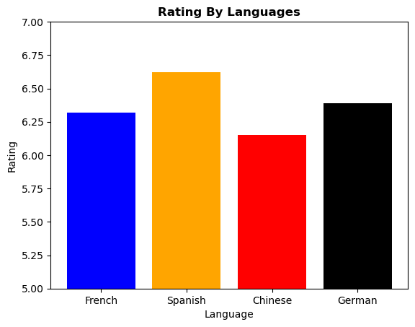
Top Movie Languages
*English 3,821

Slide 7









Top Rated Movie by Language
8.5
7.8
7.7
7.6
*minimum 1,000 votes
Notes:
Top-Rated Movies by Language (Minimum 1,000 Votes):
# - English: The Shawshank Redemption , directed by Frank Darabont, Drama, 8.5/10 (1994)
# - French: Amélie , directed by Jean-Pierre Jeunet, Comedy, 7.8/10 (2001)
# - German: Downfall , directed by Olivier Hirschbiegel, Drama, 7.7/10 (2004)
# - Spanish: Pan’s Labyrinth , directed by Guillermo del Toro, Fantasy, 7.6/10 (2006)

Slide 8
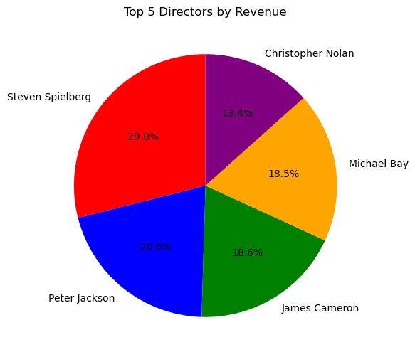
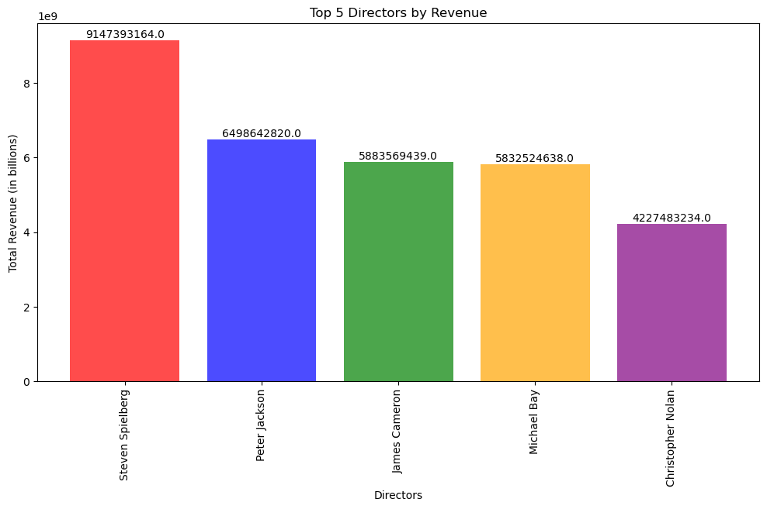
Top 5 Directors with the Highest Revenue

Slide 9
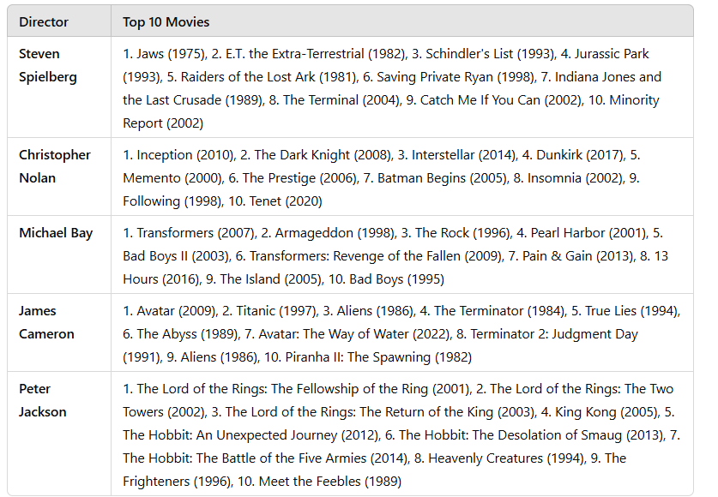

Slide 10
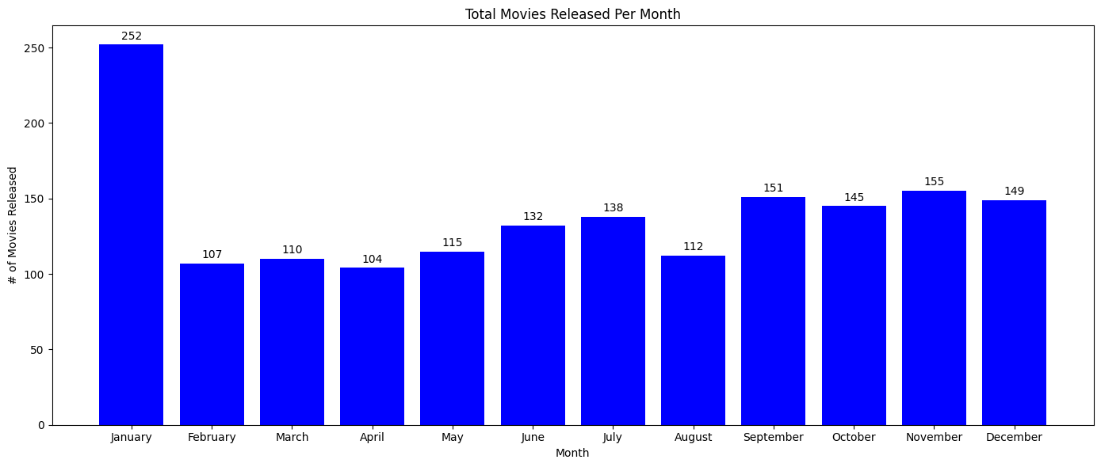
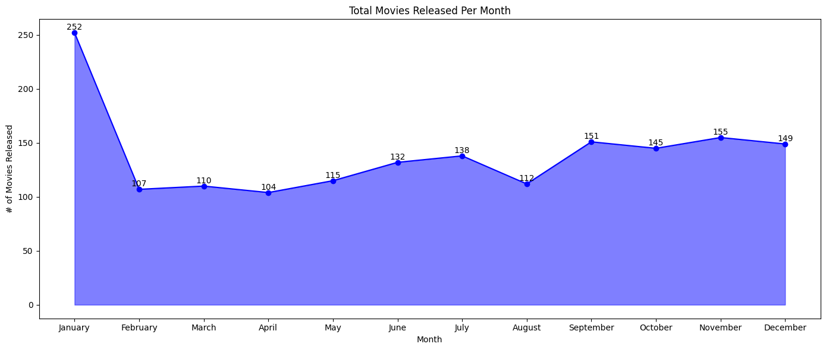
Total Number of Movies Released Per Month
Greatest Difference in Total Movies Released: January to February (145)
Notes:
Top 3 Months with the Most Movies Released:
January (252)
November (155)
September (151)
Bottom 3 Months with the Least Movies Released:
April (104)
February (107)
March (110)
Greatest Difference in Total Movies Released: January to February (145)

Slide 11
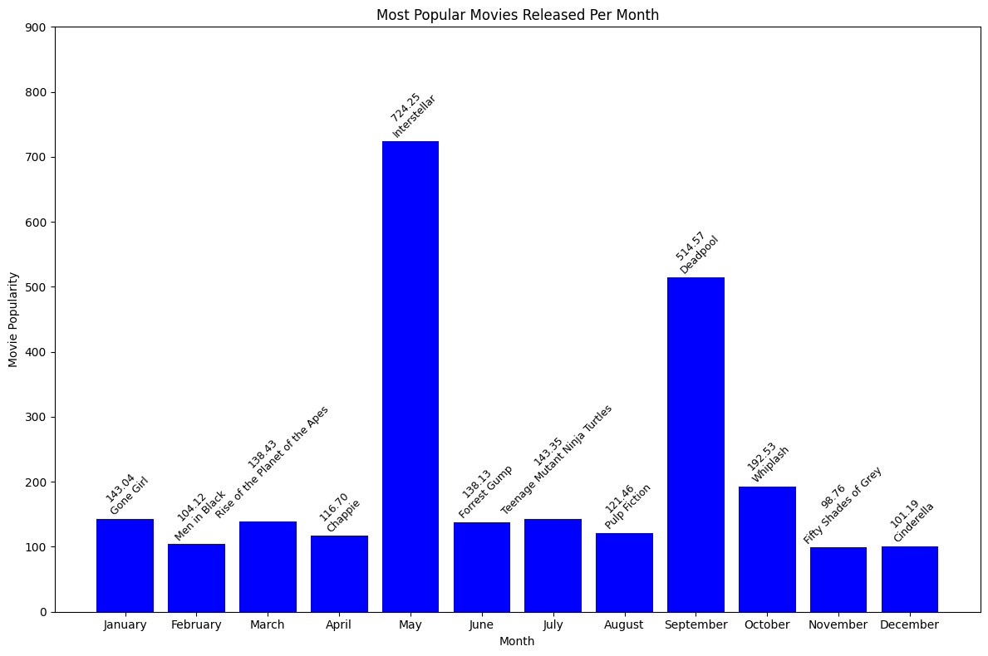
Total Number of Movies Released Per Month
Notes:
Top 3 Most Popular Movies:
May: Interstellar (724.25)
September: Deadpool (514.57)
October: Whiplash (192.53)
Bottom 3 Least Popular Movies:
November: Fifty Shade of Grey (98.76)
December: Cinderella (101.19)
February: Men in Black (104.12)

Slide 12
Project Limitations
Was there more data that you wish you had access to, but didn't have time to incorporate into your project?
2017-2024 data for pre- and post-covid comparison.
The number of audience ratings varied across movies, meaning comparisons may not fully reflect their true quality.
TMDB is an American-based platform; therefore the number of ratings for foreign films is much smaller than American films.
Some movies were missing the genres, release dates and movie director, so we couldn’t incorporate all the available data.
Actors and actresses names per movie were missing; therefore we could not calculate the top performers across films.
How did you handle missing data?
We dropped the missing data and utilized the remainder for our analyses.

Slide 13
Future Work
If you had more time, how would you expand your project?
We’d look at different metrics based on country (instead of just language).
Calculate the averages across top rated movie review sites for a non-biased insight.
Gather information about all previously missing data elements and incorporate them into our analyses.
Compare metrics across popular movie franchises.
Are there any questions that were left unanswered or half-answered?
Question 4 was changed due to lack of more current data.

